Slide 1
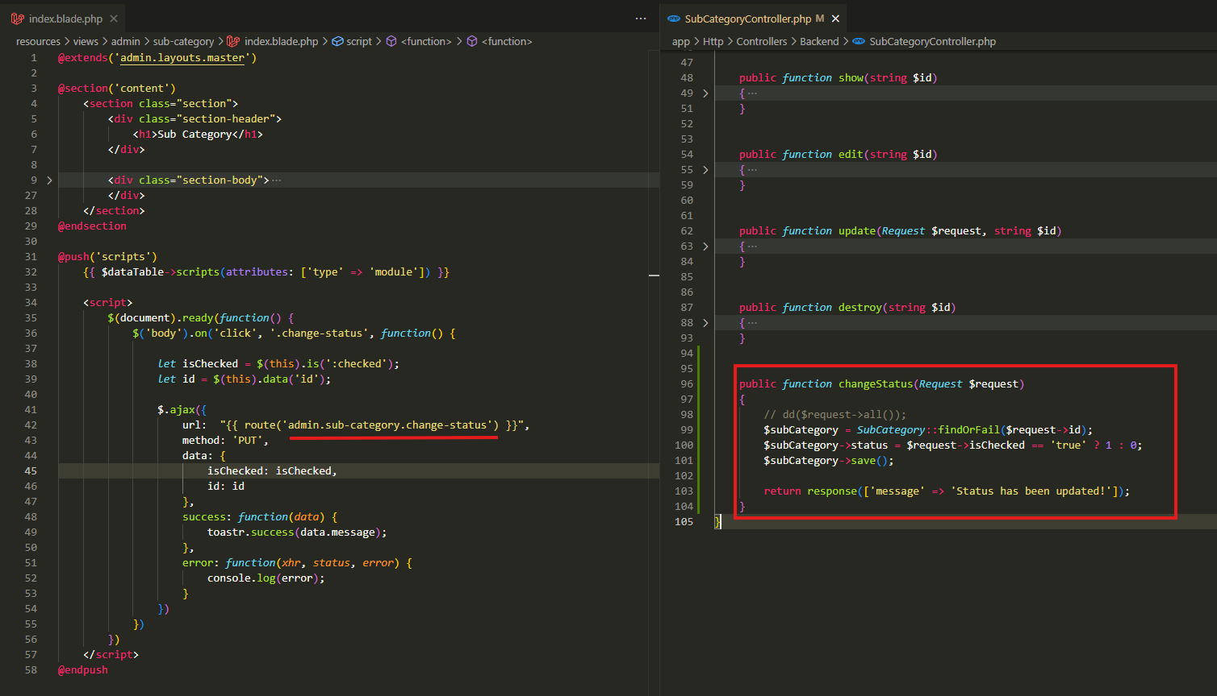
resources\views\admin\sub-category\index.blade.php
app\Http\Controllers\Backend\SubCategoryController.php

Slide 2
.

Slide 3
.

